Slide 1
Getting started as embedded Developer
(On Windows)
Sergio Zerpa
DES SDF FW

Slide 2
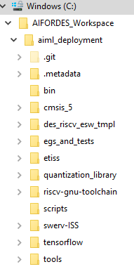
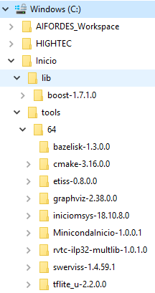
Getting started: clone repository and install tools
Open a git bash
Clone repository aiml_deployment
Update Workspace to download other repositories by running aiml_deployment/UPDATE_WORKSPACE.sh
Open a bash-shell by clicking on aiml_deployment/BASH_SHELL
Install tools by running aiml_deployment/INSTALL_TOOLS.sh
Open a NEW bash-shell by clicking on aiml_deployment/BASH_SHELL
Build tensorFlowLite only by running aiml_deployment/tensorflow/IFX_BUILD.sh --no-config --no-build
The environment is now up and running and all tests are passing!
The tersorflow repository!
The tools
The installed version of
tensorflowLite micro

Slide 3
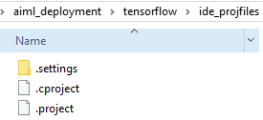
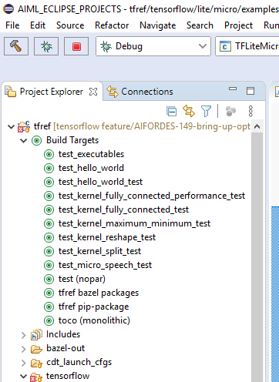
Getting started: eclipse project to work on TFL-micro
Install eclipse
Copy the eclipse project files
from aiml_deployment\tensorflow\ide_projfiles into aiml_deployment\tensorflow
Open a bash-shell by clicking on aiml_deployment/BASH_SHELL
Open your eclipse.exe from the shell
In Eclipse, import project under aiml_deployment\tensorflow into the workspace
Try running the different build-targets
test_hello_world
test_hello_world_test
test_kernel_fully_connected_test
Now, you can start contributing to TFL-micro!

Slide 4
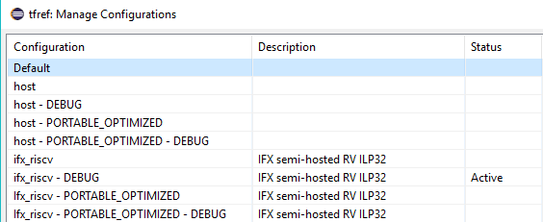
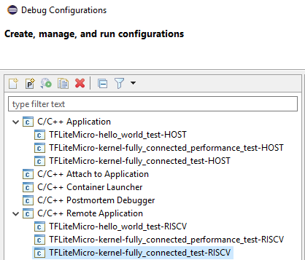
Eclipse: Existing build and debug configurations

Slide 5
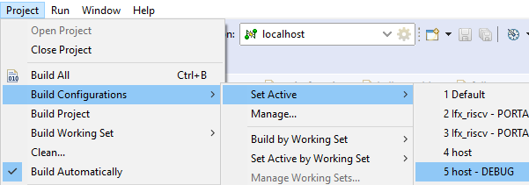
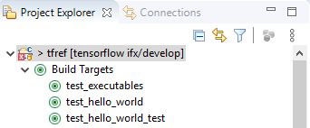

Eclipse: Debugging the hello_world_test (on the Host computer)
Select a build configuration for debugging
Build the hello_world_test
Launch the Host-Debug configuration

Slide 6
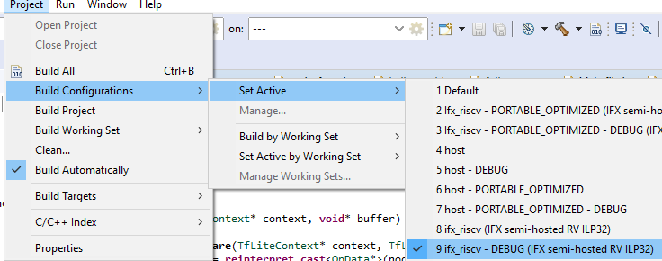

Eclipse: Debugging the hello_world_test (on the RiscV ISS)
Select a build configuration for debugging
Build the hello_world_test
Start RiscV ISS using the terminal
Open aiml_deployment/BASH_SHELL
Run the command below, making sure to use the same TCP-Port from the debug configuration
$ C:/inicio/tools/64/swerviss-1.4.59.1/bin/whisper.exe --gdb --gdb-tcp-port 1111 C:/AIFORDES_Workspace/aiml_deployment/tensorflow/tensorflow/lite/micro/gen/ifx_riscv32_mcu_rv32imac_debug/bin/hello_world_test
Launch the RISCV-Debug configuration

Slide 7
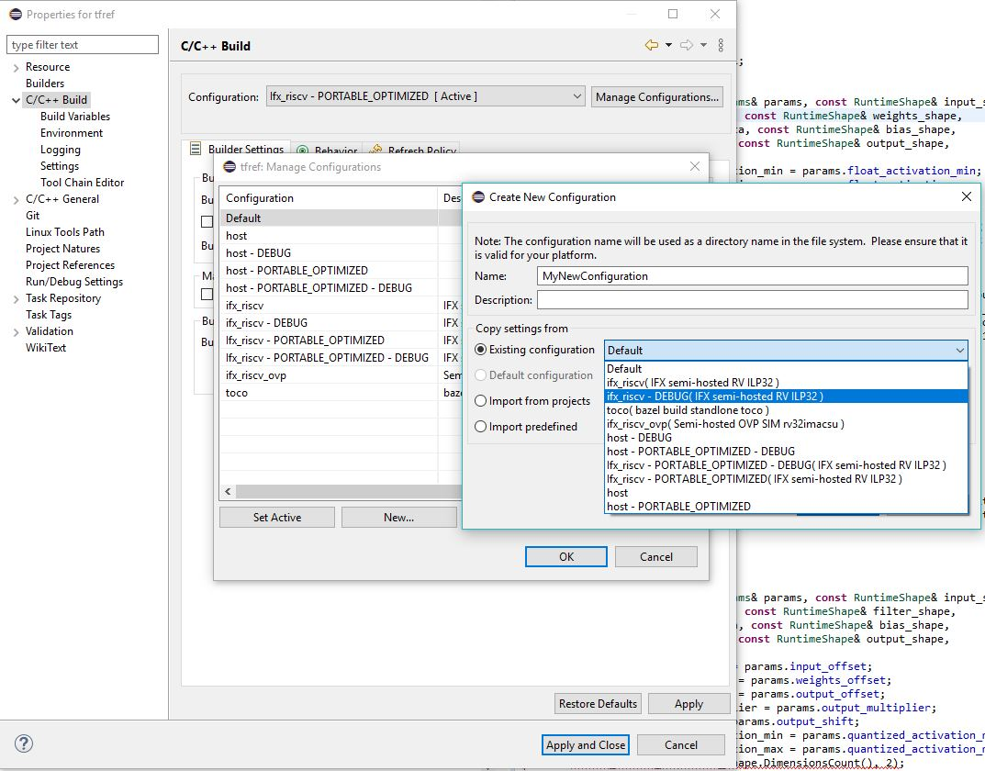
Eclipse: create a build configuration

Slide 8
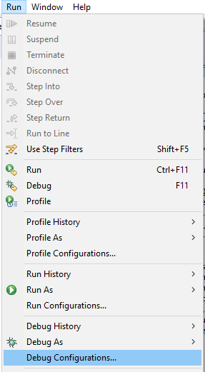
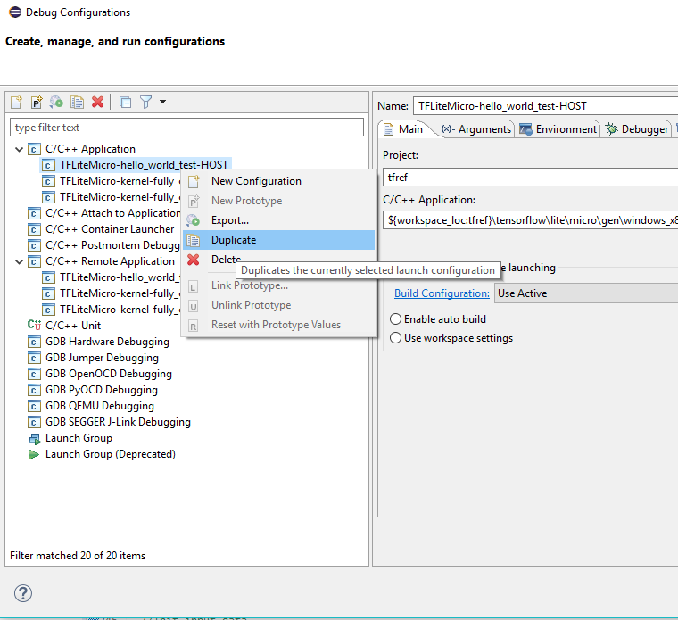
Eclipse: create a debug configuration – Local application
Open the current Debug configurations
Duplicate an existing one under C/C++ Application

Slide 9
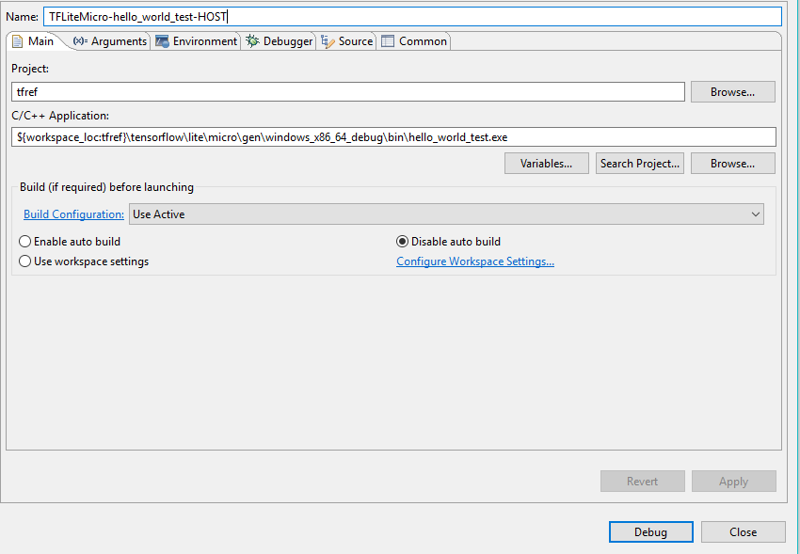
Eclipse: create a debug configuration – Local application
Change the appropiate fields on the duplicated-configuration

Slide 10
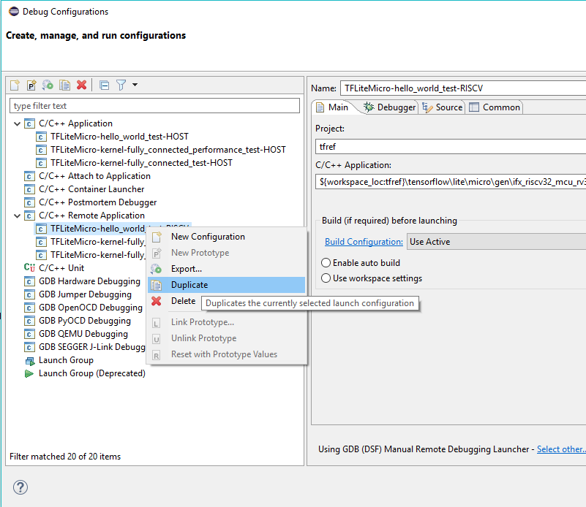
Eclipse: create a debug configuration – Remote application
Open the current Debug configurations
Duplicate an existing one under C/C++ Remote Application

Slide 11
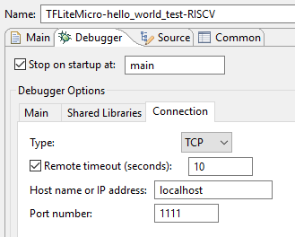
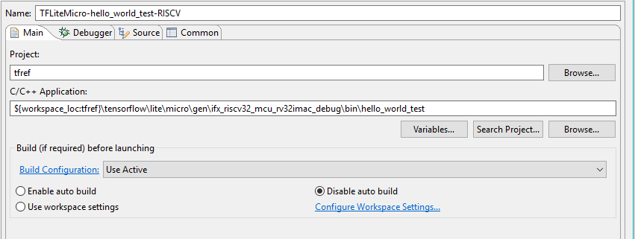
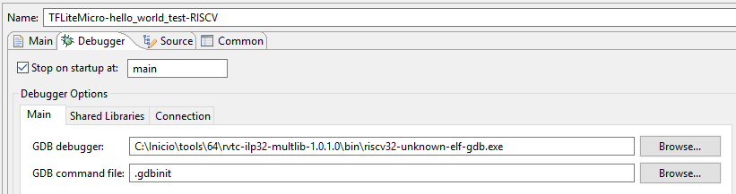
Eclipse: create a debug configuration – Remote application
Change the appropiate fields

Slide 12
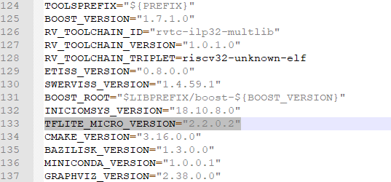
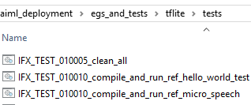
Final step: installing a new version and running integration tests
Change the version number in: aiml_deployment/SETTINGS_AND_VERSIONS.sh
Open aiml_deployment/BASH_SHELL
Navigate to aiml_deployment/tensorflow
Make install
The new version (e.g. tflite_u-2.2.0.2) is created under C:\Inicio\tools\64
Run integration tests under: aiml_deployment/egs_and_tests\tflite\tests
These tests will use the installed-version specified at
SETTINGS_AND_VERSIONS.sh

